Slide 1

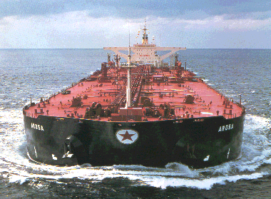
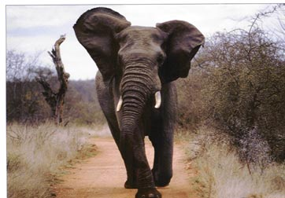
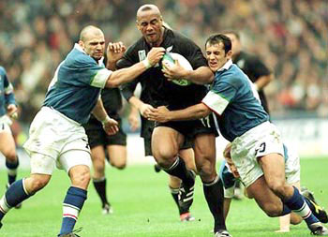
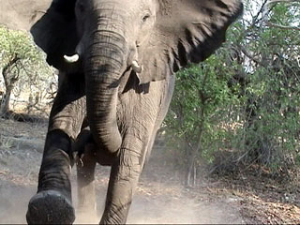
Why can’t it stop easily ??
HARD TO STOP
1. It is MASSIVE
2. It is FAST
IT has a lot of MOMENTUM

Slide 2




MOMENTUM

Slide 3
MOMENTUM
=
MASS
VELOCITY
X
p = m v

Slide 4
UNITS of MOMENTUM
Mass x velocity = kg x m s⁻¹ = kg ms⁻¹
But the preferred unit of Momentum is N s
NEWTON SECONDS

Slide 5
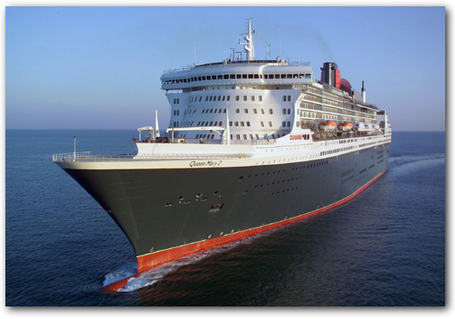
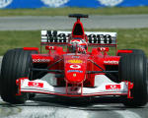
m = 150 000 tonnes
v = 25 knots = 12.5 m s⁻¹
p = ?
150 000 000 kg x 12.5 ms⁻¹
= 1875 000 000 kg ms⁻¹
QM2
= 1.875 x 10⁹ N s
m = 650 kg
v = 200 mph = 89 m s⁻¹
p = ?
650 kg x 89 ms⁻¹= 57 850 kg ms⁻¹
Ferrari F1
= 5.785 x 10⁴ N s

Slide 6
THE PRINCIPLE OF CONSERVATION OF MOMENTUM
THE TOTAL MOMENTUM OF A SYSTEM
IS CONSTANT,
PROVIDING THAT NO EXTERNAL FORCES ARE ACTING ON IT

Slide 7
THE PRINCIPLE OF CONSERVATION OF MOMENTUM
This principle applies to collisions and to explosions
so
BEFORE
AFTER
u₁
m₂
m₂
v₂
m₁
u₂
m₁
v₁
m₁u₁ + m₂u₂ =
m₁v₁ + m₂v₂
REMEMBER THAT MOMENTUM IS A VECTOR QUANTITY
VECTOR QUANTITY
VECTOR QUANTITY
VECTOR QUANTITY
VECTOR QUANTITY

Slide 8
BANG !
2kg
4kg
2ms⁻¹
4ms⁻¹
2kg
4kg
2ms⁻¹
4ms⁻¹
2kg
4kg
2.5ms⁻¹
x = ?
MOMENTUM BEFORE
=
MOMENTUM AFTER
By the Principle of Conservation of Momentum
2 x 2 + 4 x (-4) = 2 x (-2.5) + 4 x
4 - 16 = -5 + 4 x
x = - 1.75 m s⁻¹
Note that the 4 kg ball was moving to the left initially

Slide 9
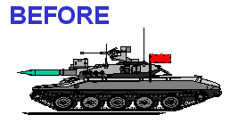
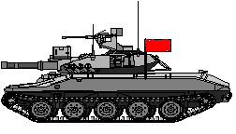
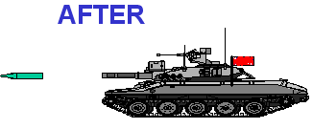
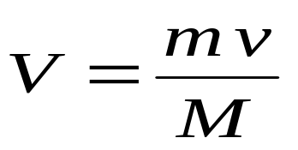
THE PRINCIPLE OF CONSERVATION OF MOMENTUM
This principle applies to collisions and to explosions
m = mass of shell
M = mass of tank
Momentum = 0
ENEMY
HQ
mass M
velocity V
mass m ,
velocity v
By the Principle of Conservation of Momentum
Taking to the right as positive
0 = - m v + M V
After it has fired the shell, the initial recoil velocity of the tank is given by

Slide 10
ELASTIC AND INELEASTIC COLLISIONS
MOMENTUM IS CONSERVED IN ALL COLLISIONS
KINETIC ENERGY IS ONLY CONSERVED FOR ELASTIC COLLISIONS
FOR EXAMPLE COLLISIONS BETWEEN ATOMS OF A MNOATOMIC GAS

